Slide 1

Novel convolutional Embedding for Domain adaptation in Medical segmentation
PRESENTED BY sURF 2022053
Supervisor: Erick Purwanto

Slide 2

WITH GREAT THANKS TO…
Supervisor, Research Assistants, Volunteers and SURF members in SC440, whose efforts are essential.

Slide 3
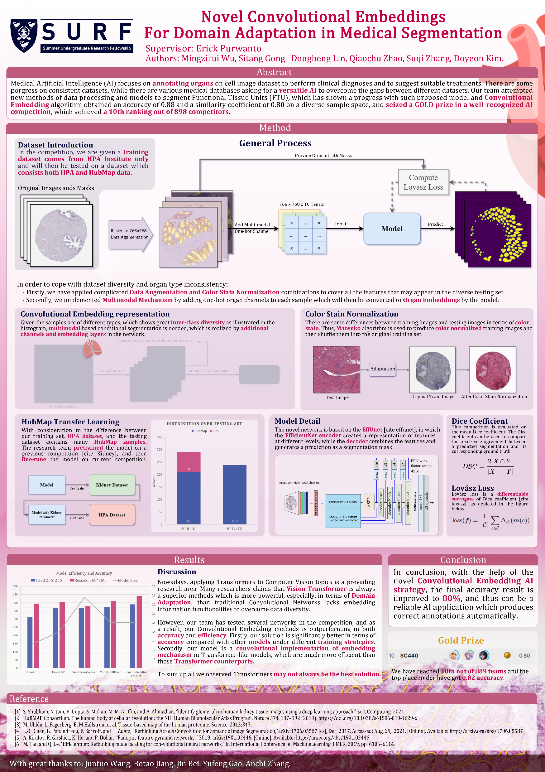
Content
Background & Motivation
Introduction
Techniques
Data Preprocessing
Neural Network Training
Discussion
Conclusion

Slide 4
background & Motivation
Medical Artificial Intelligence

Slide 5
motivation
Why study?
Purpose of Artificial Intelligence in medical field:
Image datasets: Biopsy Scan, etc.
Diagnostics
Treatment protocol development
To create AI with higher accuracy

Slide 6
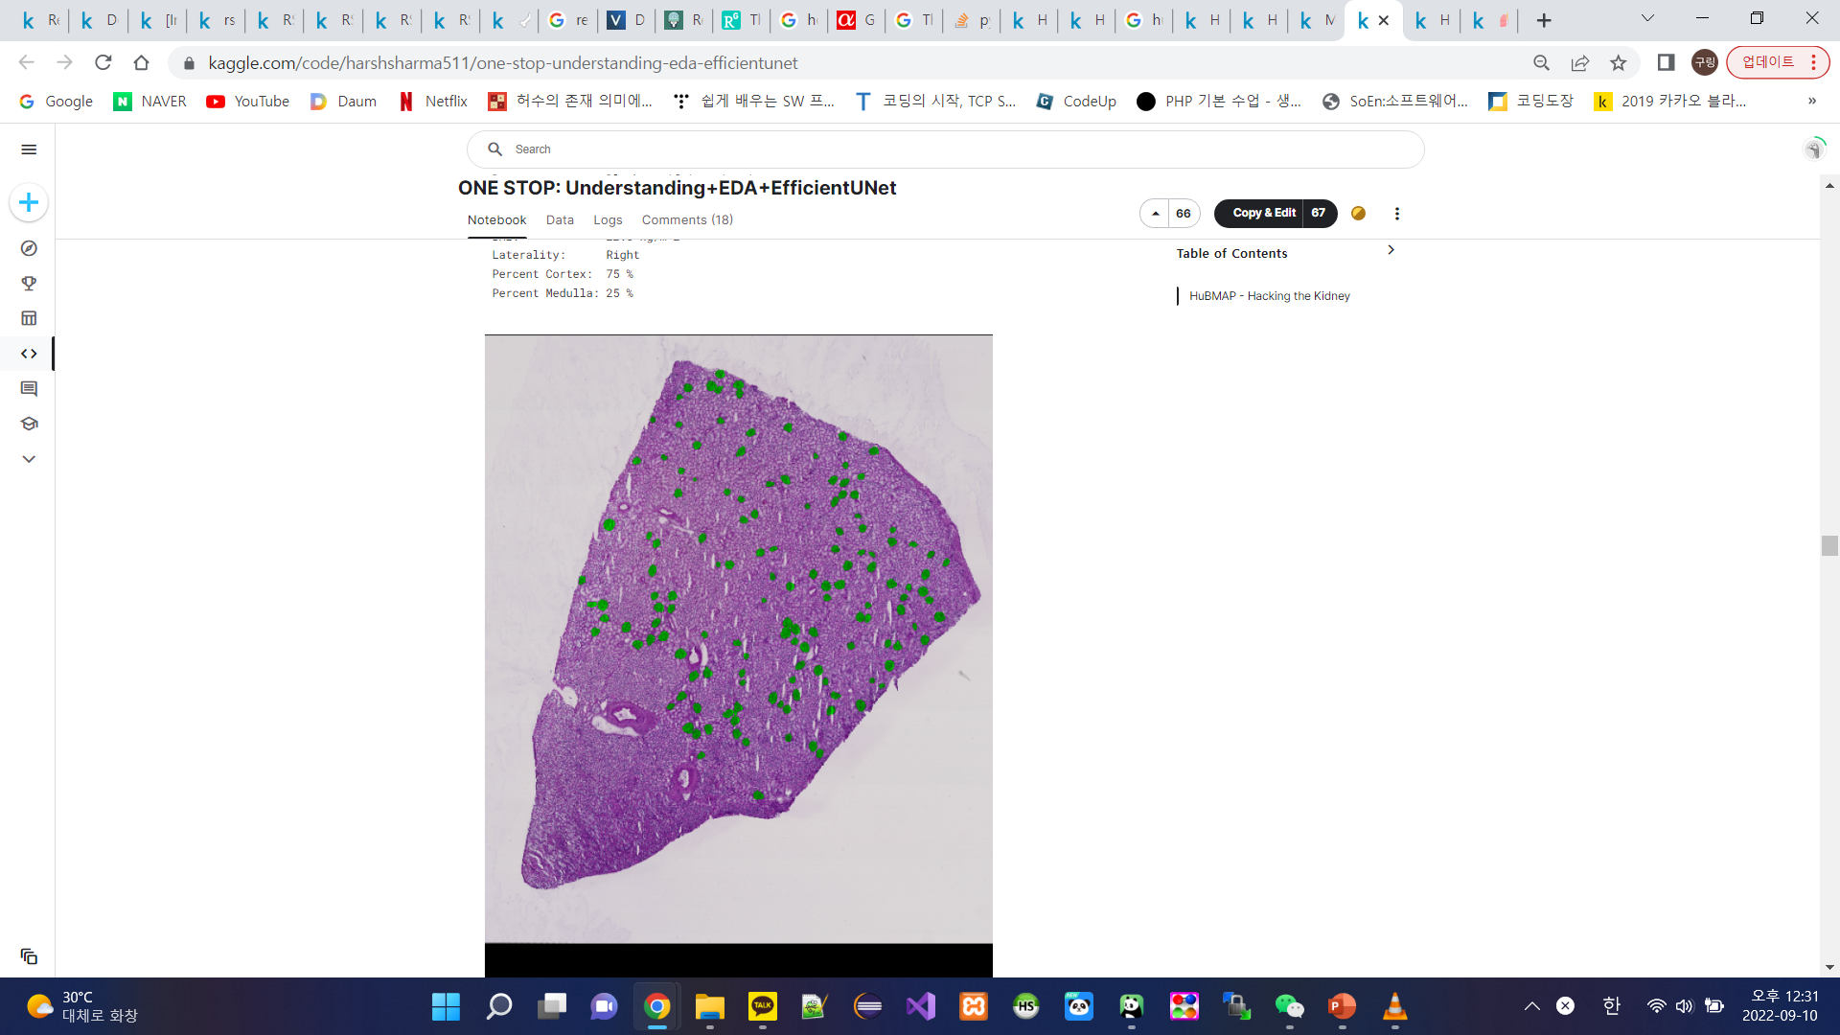
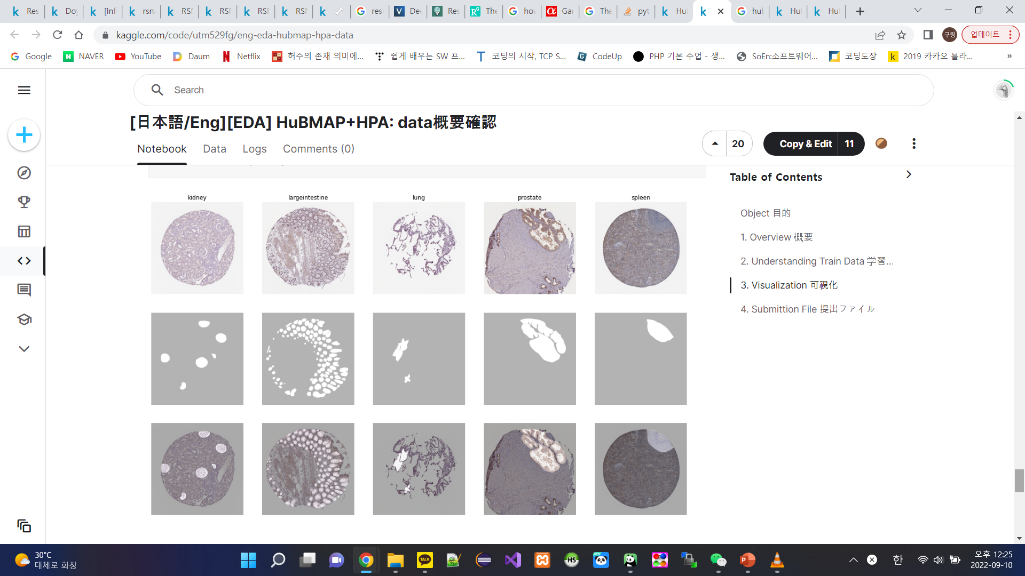
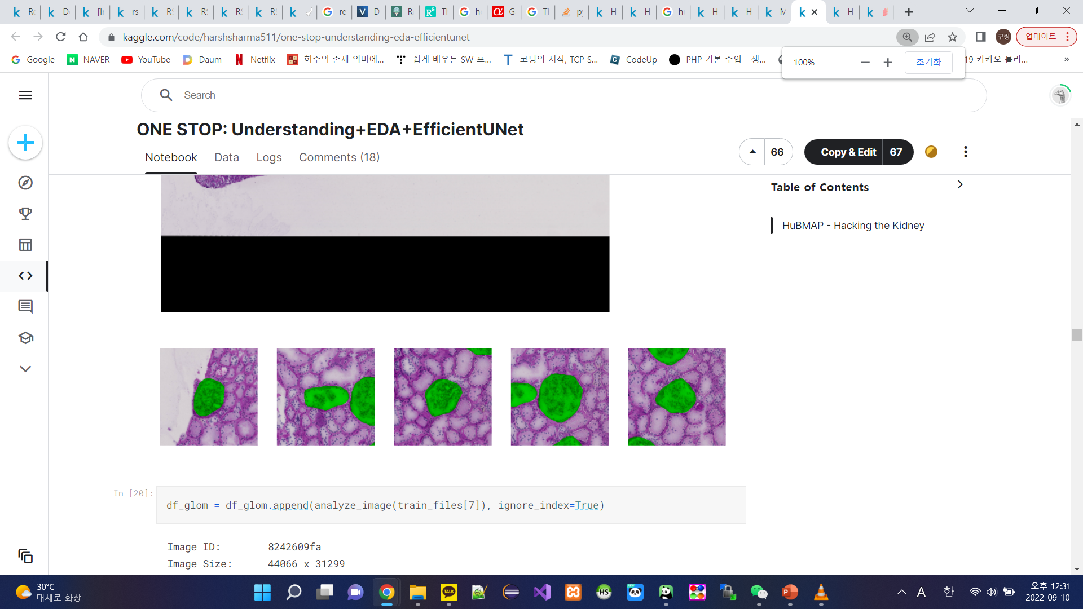
Difference: known & our solution
Known solution: focus on single-organ dataset (kidney)
Our solution: generalize over multi-organ dataset (prostate, spleen, lung, kidney, large intestine)
Single-organ dataset
Multi-organ dataset

Slide 7
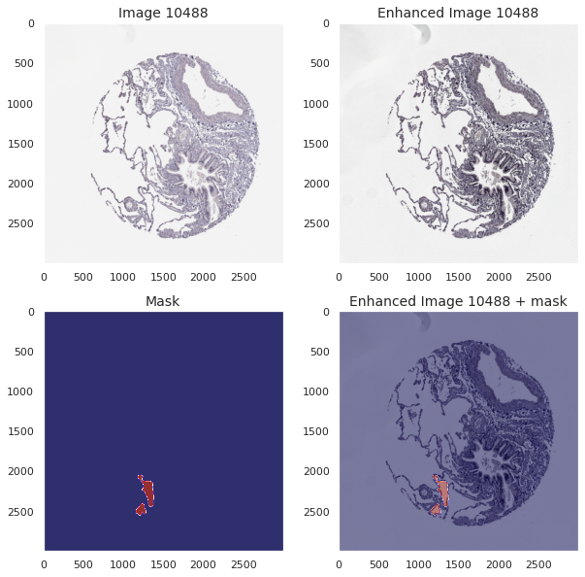
background
Catch the characteristics of each Organ slice
New methods
→ Data processing
→ Novel models to segment Functional Tissue Units (FTU)
Medical Image Segmentation (Annotation)

Slide 8
introduction
Challenges and our goals

Slide 9
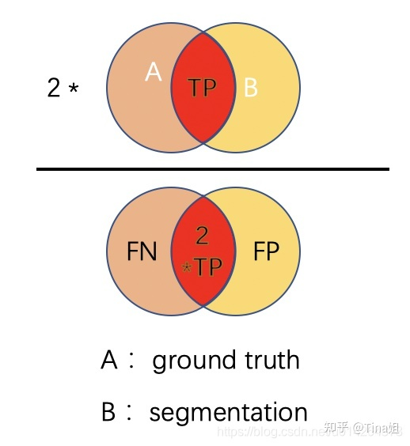
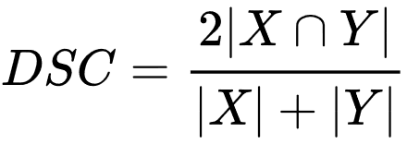
Competition introduction
In this research, we are given a dataset consists of biopsy images and their masks from five different organs: kidney, prostate, large intestine, spleen, and lung made by different institutes, we want to annotate the Functional Tissue Units within them. The annotation precision is evaluated by the Dice coefficient depicted below.

Slide 10
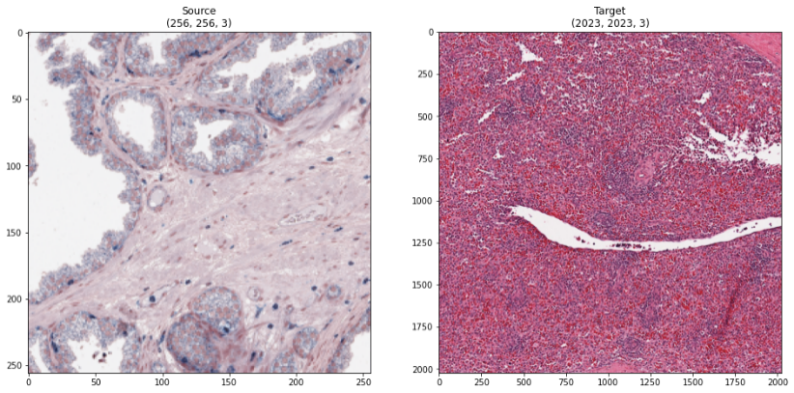
Challenges
The dataset itself suffers from inconsistency among samples. Therefore, it can represent the common problem of domain adaptation in medical AI industry.
Traditional methods are unlikely to perform well, for they lack generalization ability.
Data Inconsistency in resolution, scale, color stain and shape

Slide 11
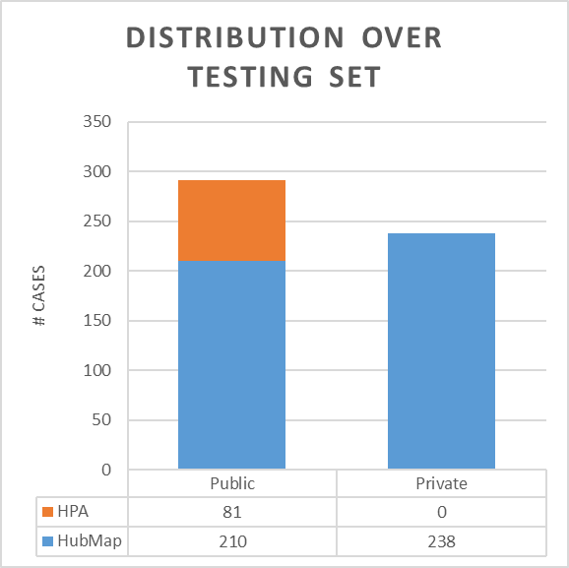
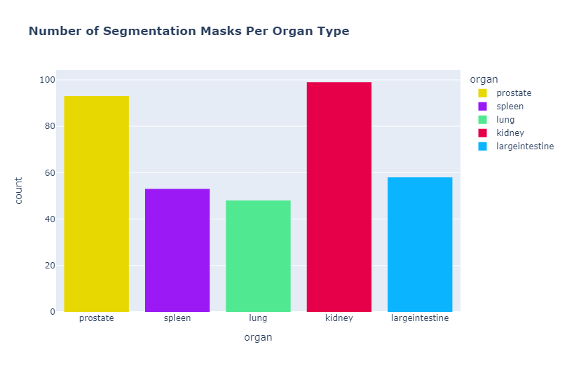
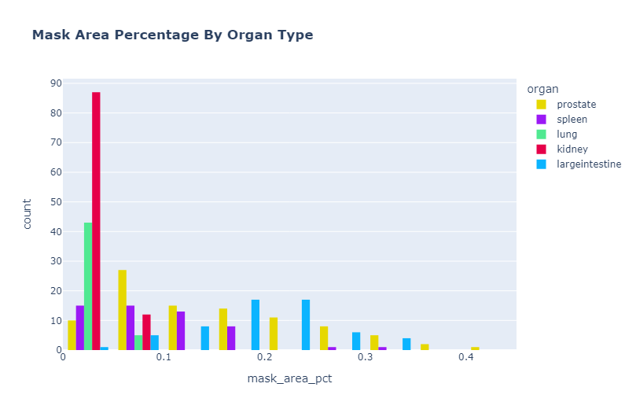
Challenges
Imbalanced sample distribution is another problem we want to deal with in the competition.
That means, the AI will have more preference to the features in the majority types in the dataset, and thus performs bad on minority samples.

Slide 12
Techniques
OUR solutions to the challenges

Slide 13
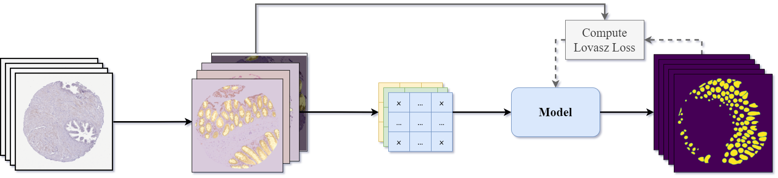
Our general PROCESS
In general, to cope with dataset diversity and organ type inconsistency:
Firstly, we have applied complicated Data Augmentation and Color Stain Normalization combinations to cover all the features that may appear in the diverse testing set.
Secondly, we implemented Convolutional Embedding Mechanism by adding one-hot organ channels to each sample which will then be converted to Organ Embeddings by the model.
Provide Ground-truth Masks
768 x 768 x 10 Tensor
Resize to 768x768
Data Augmentation
Add additional
One-hot Channel
Predict

Slide 14
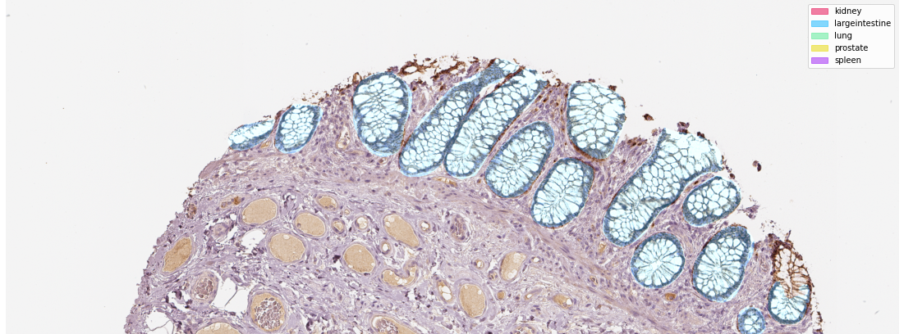
Data PROCESSING
Data techniques

Slide 15
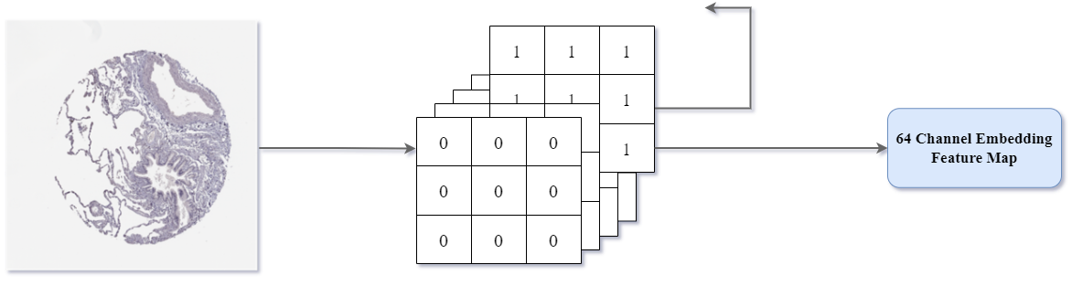
Convolutional Embedding Representation
Given the samples are of different types, which shows great inter-class diversity, embedding based conditional segmentation is needed, which is realized by additional channels and embedding layers in the network.
e.g. given a image sample of lung made by HPA
All tensors in Lung Channel and HPA channel are set to 1
Channel Expansion
3x3 and 2 Stride convolution

Slide 16
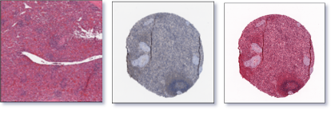
Color Stain Normalization Preprocessing
Adaptation
Normalization
As we mentioned, there are some differences between training images and testing images in terms of color stain.
Thus, Macenko algorithm is used to produce color normalized training images and then combine them with the original training set.

Slide 17
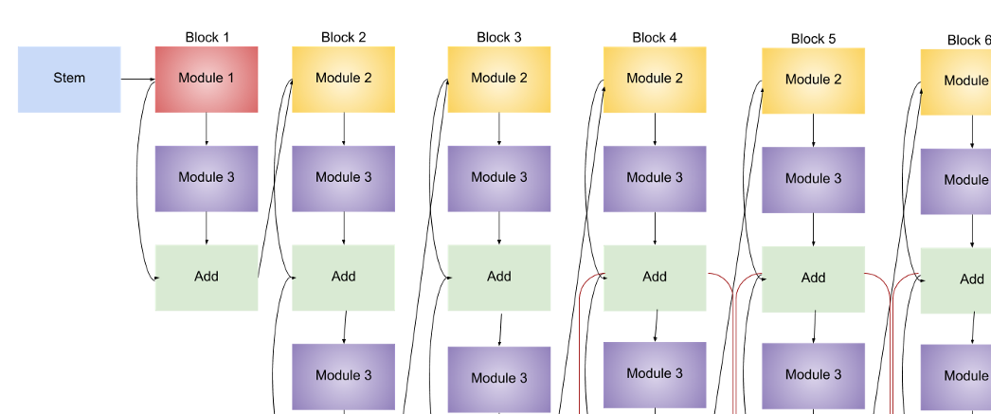
Neural Network Training

Slide 18
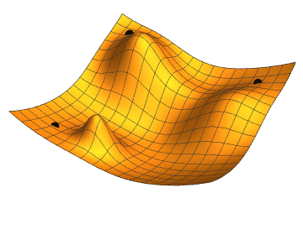
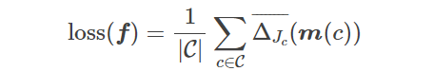
During TRAINING…
We want to optimize the dice coefficient, but…
Dice is not a differentiable function!
We use Lovász loss instead:
Lovász loss is a differentiable surrogate of Jaccard coefficient (A similar metric to Dice coefficient) and thus can be used for optimizer which requires gradient.
The loss function is given by formula:

Slide 19
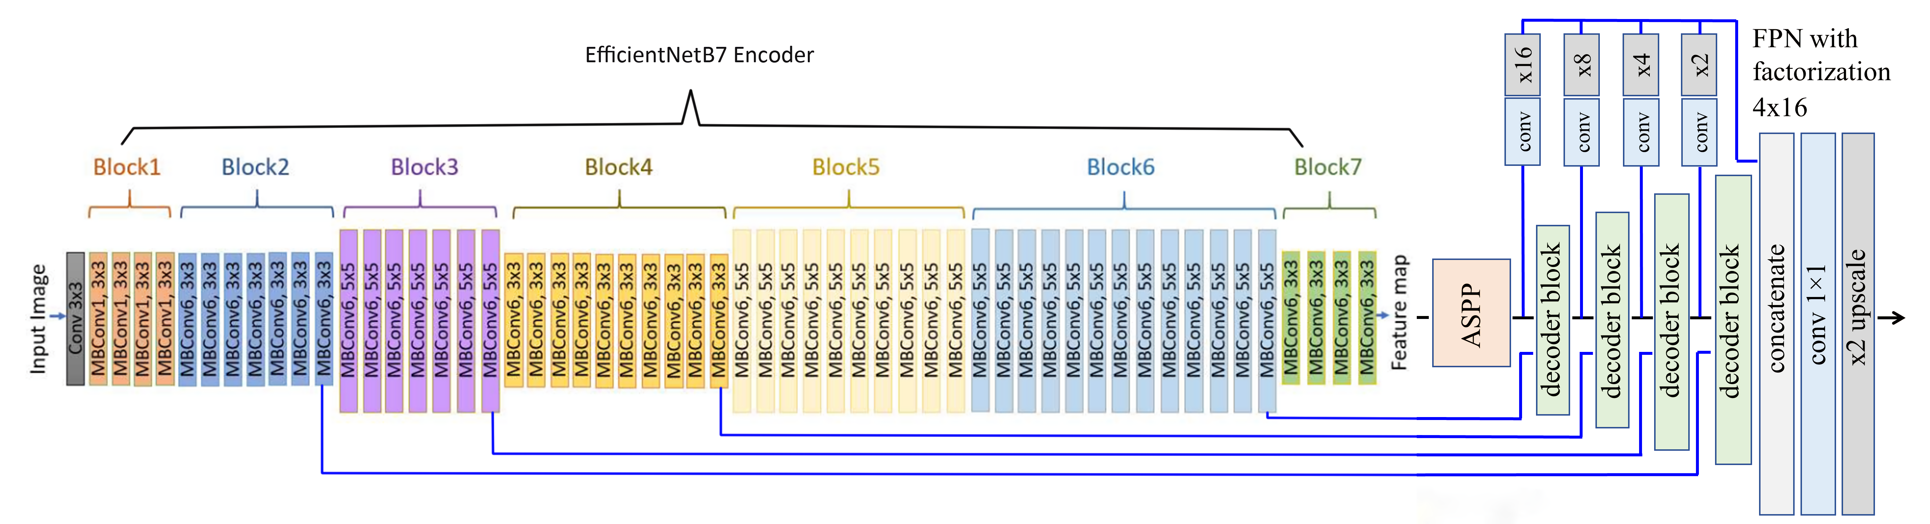
Model ARCHITECTURE
The model is based on a famous structure of Effunet which uses:
EfficientNet as a encoder creates representation of features at different levels,
While the decoder combines the features and generates a prediction as a segmentation mask.

Slide 20
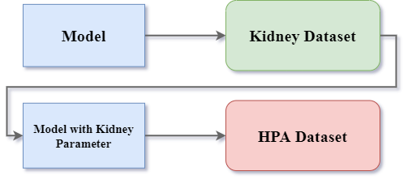
HubMap Transfer Learning
With consideration to the difference between our training set, HPA dataset, and the testing dataset contains many HuBMAP samples. The research team pretrained the model on a previous competition, and then fine-tune the model on current competition.

Slide 21
Discussion
Observation from results

Slide 22
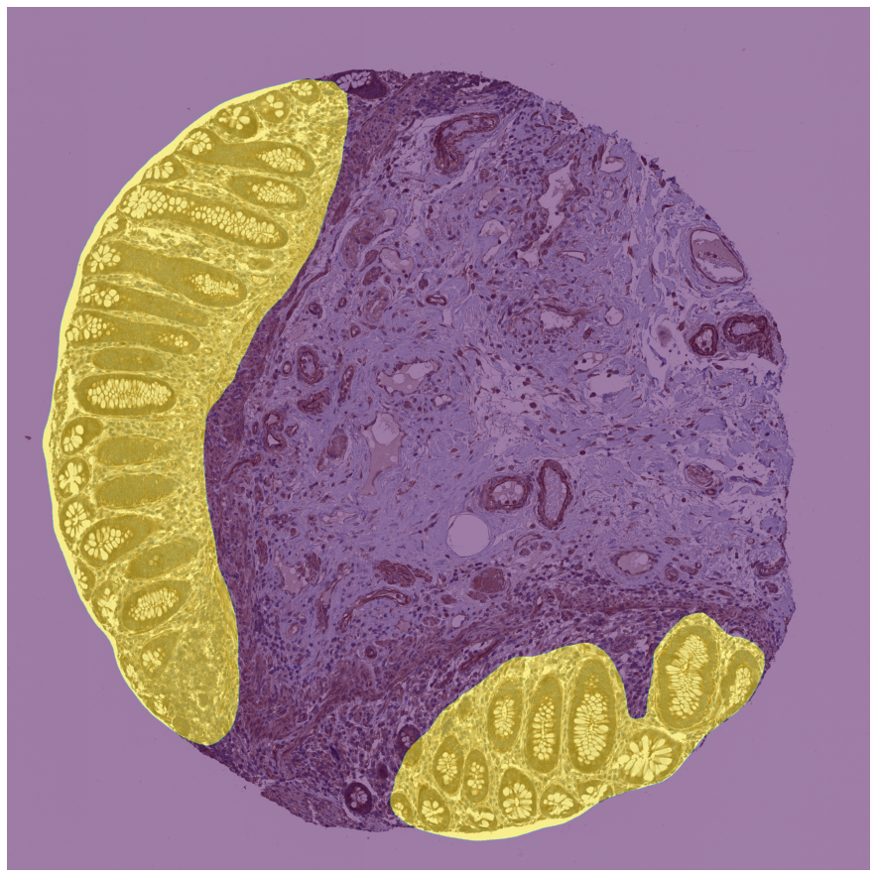
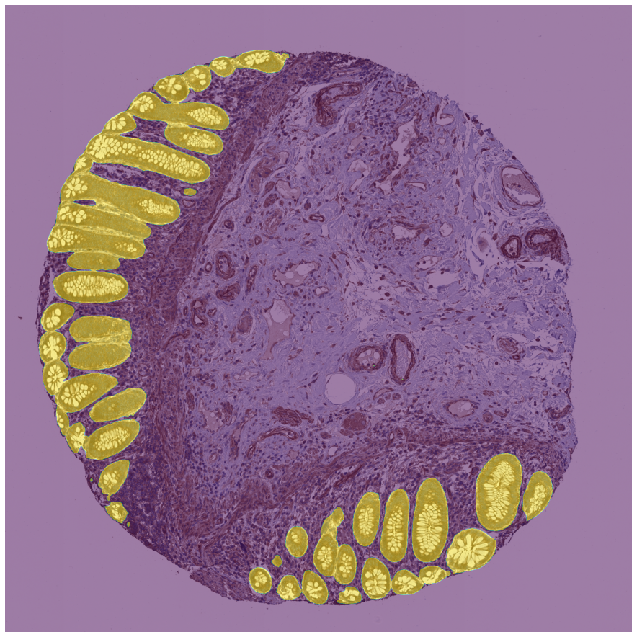
Result comparison
25% of benchmark improvement!
Vanilla Solution from Kidney competition
Dice = 0.56
Our solution
Dice = 0.82

Slide 23
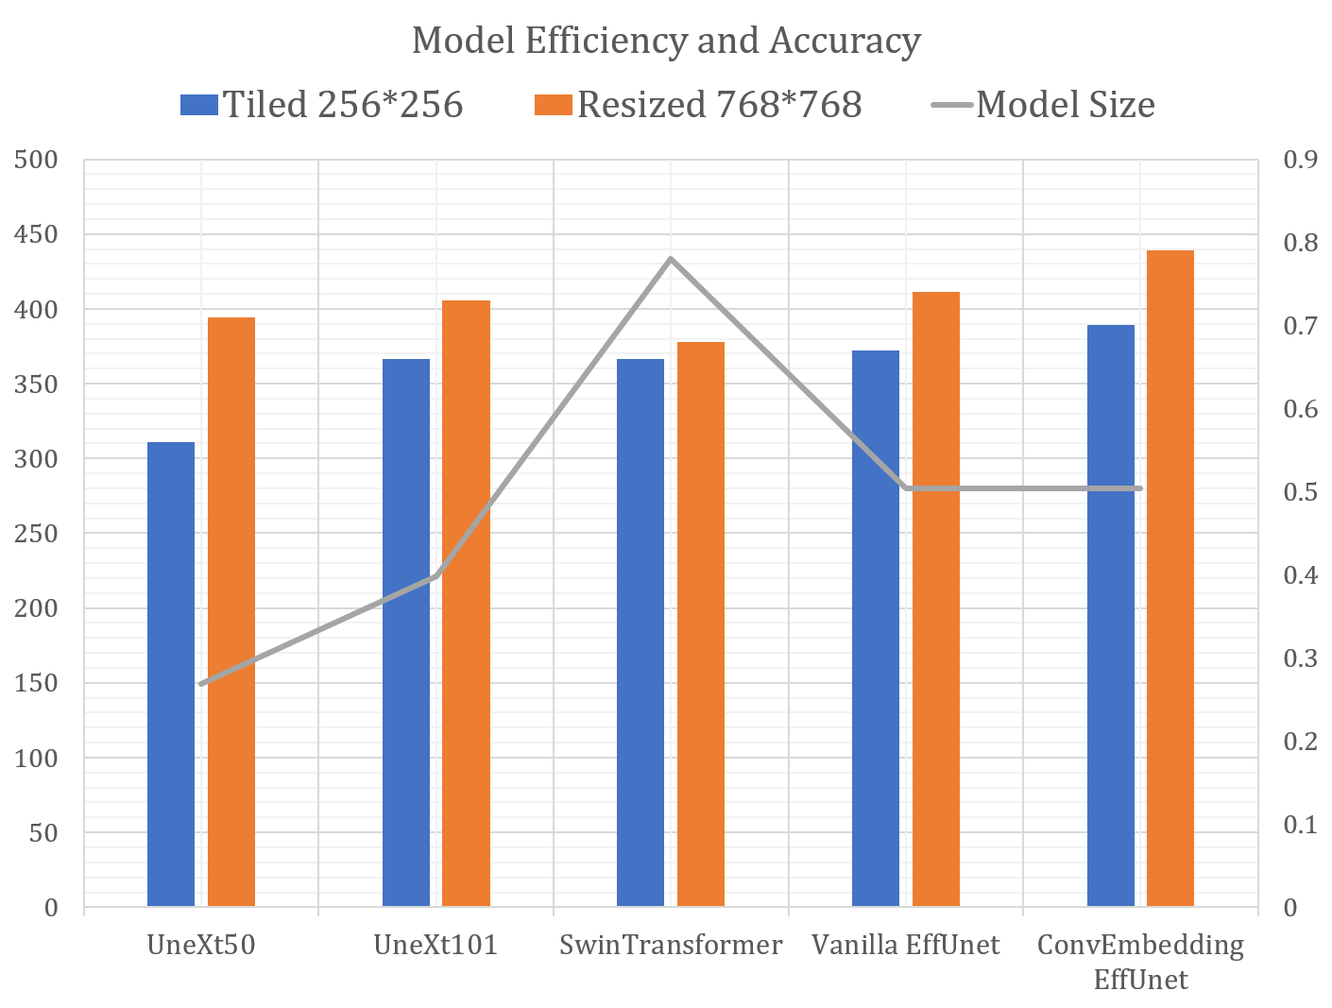
Discussion
Applying Transformers to Computer Vision is a prevailing research area, which many researchers believed the Vision Transformers are superior than convolutional networks.
But fully convolutional networks combined with our Convolutional Embedding method is proved to be outperforming in our experiment.
The model achieves 0.82 in the public testing set and which is 12% higher than SwinTransformer's score, while the size of the model is as small as 60% of the SwinTransformer solution

Slide 24
Conclusion
summary & FUTURE PLAN

Slide 25
conclusion
Automated image detection with multi-class dataset = challenging
Deep learning training based on:
Accurate Optimization
Efficientnetb7
Transfer learning
Image preprocessing
Result = organ metadata embedding; improves performance
→ Simpler convolutional model in Medical Segmentation

Slide 26
Future studies
Catalyze novel views on tissue organization
Gene and protein expression patterns defining cells, phenotypes and functional interactions
Easily accessible, publicly available user interface
Be able to browse, search, download and analyze the data in standard formats

Slide 27
Conclusion
THANKS FOR LISTENING

